Slide 1
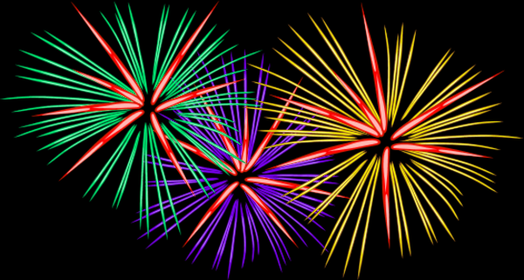
Our holidays!
By: Emilija Eimantaitė 8A

Slide 2
September the 1st
We celabrate this holiday after the summer break. We come to school to give our teachers flowers and start a new year of learning. We don’t learn that day, the lessons start only the next day.

Slide 3
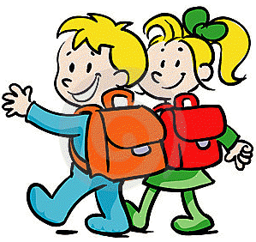
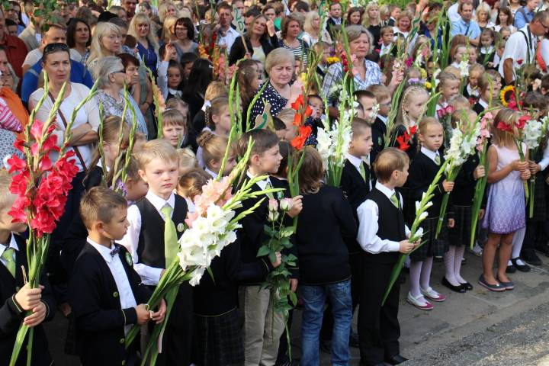

Slide 4
Teacher’s day
The 5th of October is a day when teacher’s become students and the 12th graders teach the others. Each student chooses the subject they want to teach. We also have shorter lessons, they are only 30 minutes, instead of 45 minutes. The students usually give their teachers flowers on that day.

Slide 5
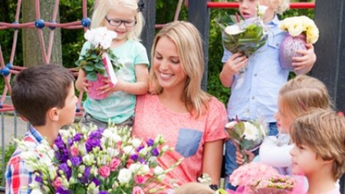

Slide 6
January the 13th
January the 13th is Independence defenders‘ commemoration day.
We honour them by lighting candles and by 1 minute of silence. We remember this day every year and we are very grateful.

Slide 7
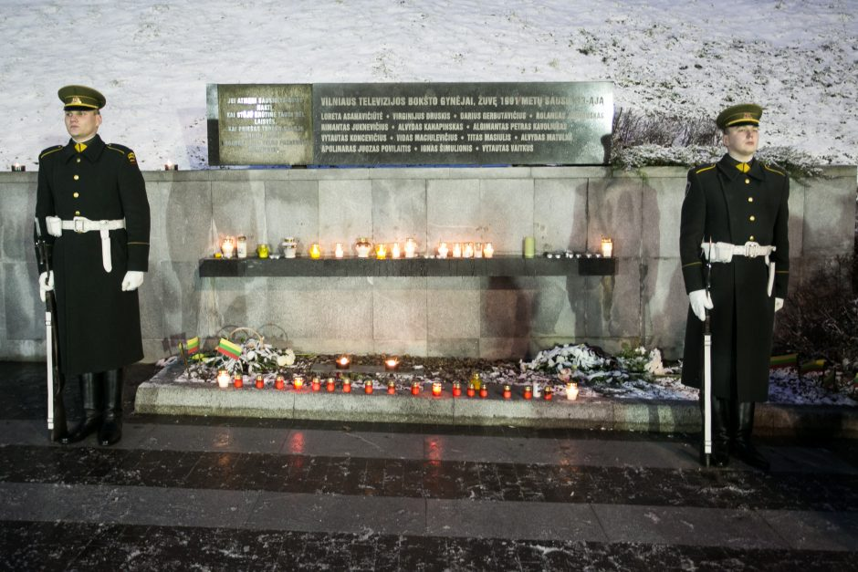

Slide 8
The last bell
We end the school year on the last day of May.
This is the happiest day in students‘ life. All students and teachers gather in the school yard. The headmaster awards the best students.

Slide 9
